Slide 1
Presentation Skill Training
Communication Strategy
Process
Skills

Slide 2
Communication Strategy
Speaker strategy
Message
Speaker
Audience
Response

Slide 3
What are your objectives
General objective Broad goals
What you are doing
What you hope to be doing
What problem you are trying to solve

Slide 4
What are your objectives
Action objective Specific,measurable,time-bound steps
To accomplish a specific result by a specific time

Slide 5
What are your objectives
Communication objective Based on action objective, “As a result of this communication, my audience will .”
How you hope your audience will respond to your communication.

Slide 6
What managerial style do you choose
Managerial Style
TELL(inform): you want your audience to learn
low
JOIN
SELL(persuade):you want your audience to act
Speaker
control
CONSULT
SELL
CONSULT(interact): you want both yourself and your audience to learn
TELL
high
low
high
Audience Involvement
JOIN(collaborate): you want both yourself and your audience to act

Slide 7
Objective VS Style
Tell/Sell <==> 1.Have sufficient information
2.Can understand that information without help from others
3.Are concerned primarily with the quality of the decision
Consult/Join<==> 1.Need move information
2.Need critical evaluation from others
3.Concerned primarily with implementation

Slide 8
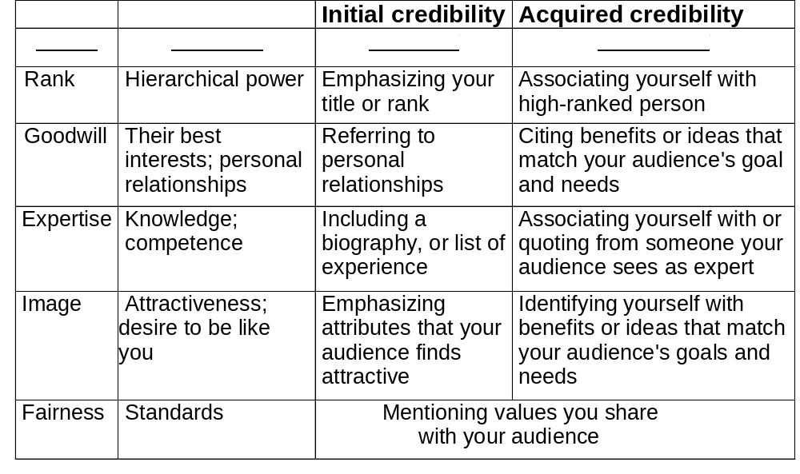
What is your credibility

Slide 9
Communication Strategy
Audience analysis strategy
Message
Audience
Speaker
Audience
Response

Slide 10
Audience Inventory
Who are they?
  Primary audience:
  Secondary,or hidden,audience: will hear about, need to approve ,or be affected by it.
  Leader: key decision-maker
What do you know about them?
  As individuals;
  As group members;
  As they related to you.

Slide 11
Audience Inventory
what do they know?
  About you: Who are you?
    Who or what do you represent?
  About your topic: What do they know about your topic?
    What is their attribute toward it likely to be?
  About your How do they perceive your relationship to
  relationship to your topic?
  your topic: How do they perceive your expertise reputation ?

Slide 12
How can you motivate your audience
Punish or reward them
Appeal to their growth needs
Use people need for “balance”
Perform a cost/benefit analysis

Slide 13
Communication Strategy
Message structure strategy
Message
Speaker
Audience
Response

Slide 14
What do you want to emphasize
Audience Memory Curve
Most
Least
Beginning
End

Slide 15
Is your audience likely to agree; interested in results, very busy?
Choose a direct strategy: state generalization or conclusion first then provide specific, support
Present your views first
use your strongest evidence first

Slide 16
Is your audience likely to disagree, interested in analysis
Choose an indirect strategy: spell out support first, then finish with your generation or conclusion

Slide 17
Process
1.Prepare your presentation
2.Select your visual aids

Slide 18
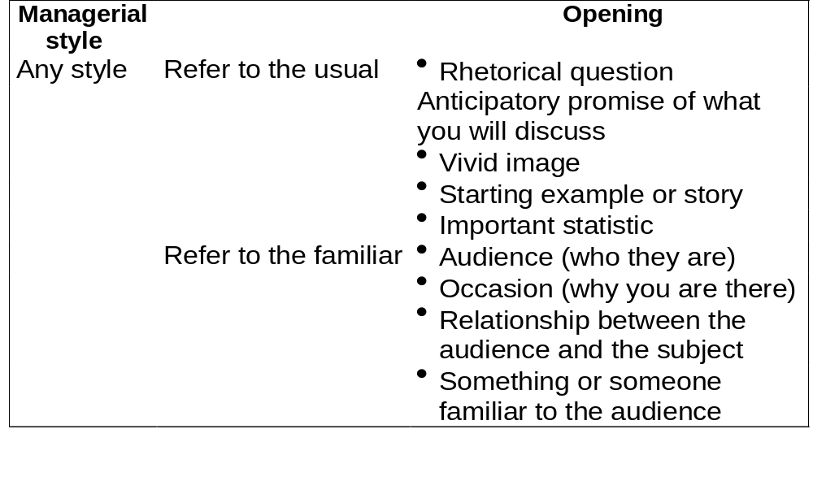
Prepare Your Presentation
Using an effective opening

Slide 19
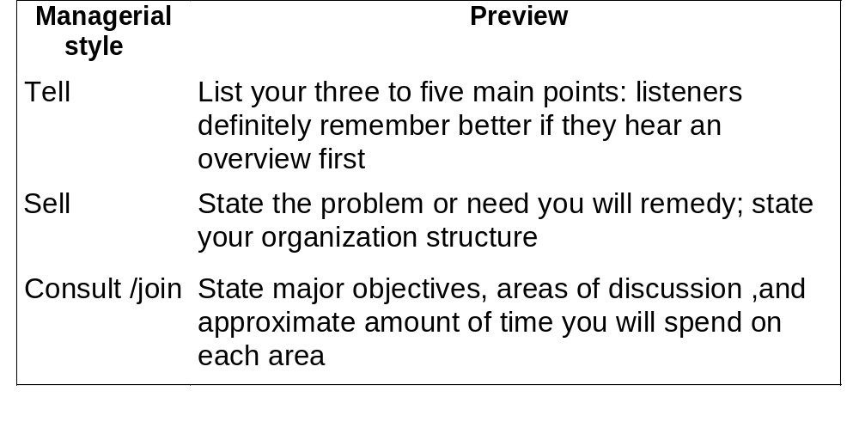
Prepare Your Presentation
Include a preview

Slide 20
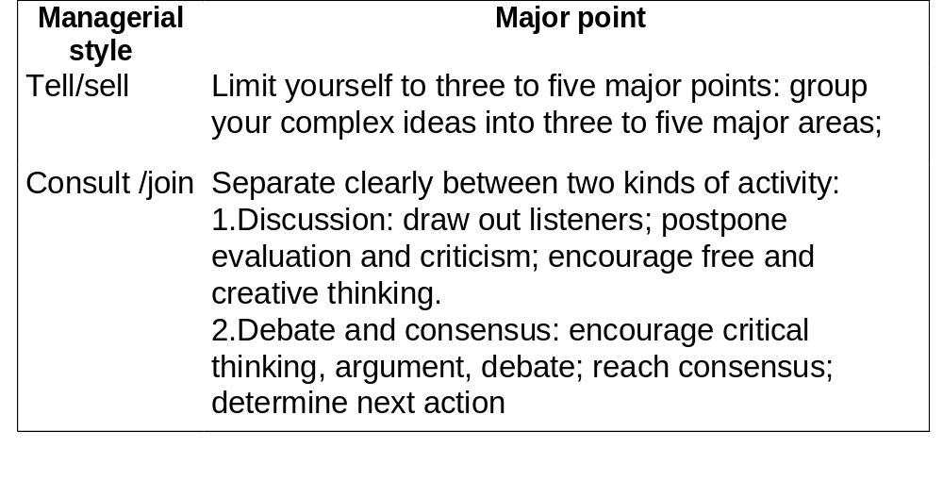
Prepare Your Presentation
Limiting your main point

Slide 21
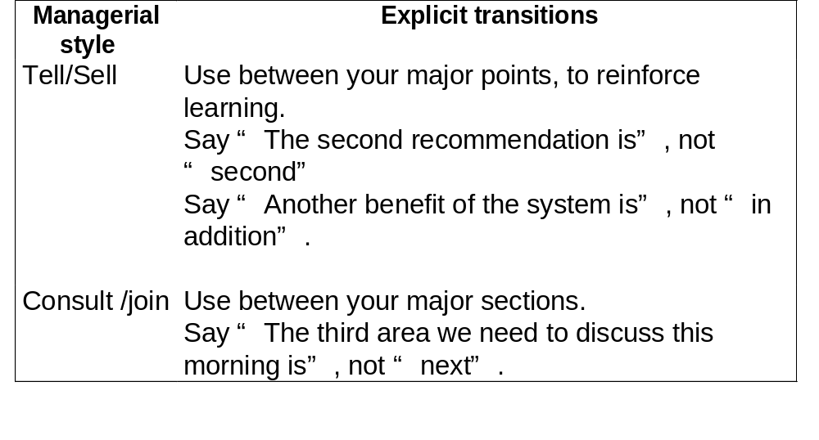
Prepare Your Presentation
Using explicit transitions

Slide 22
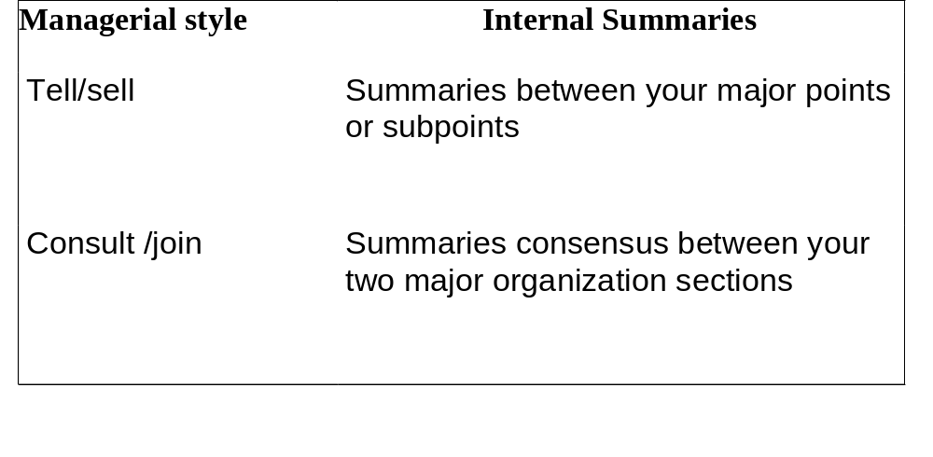
Prepare Your Presentation
Using internal summaries

Slide 23
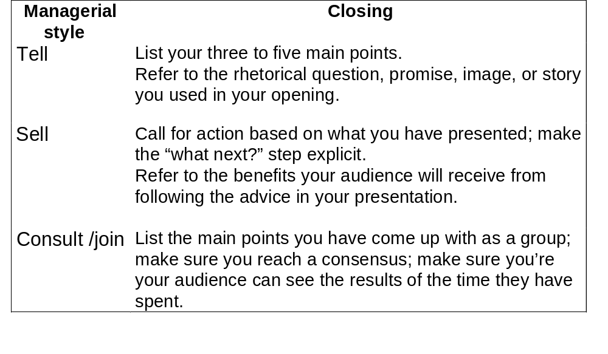
Prepare Your Presentation
Using an effective closing

Slide 24
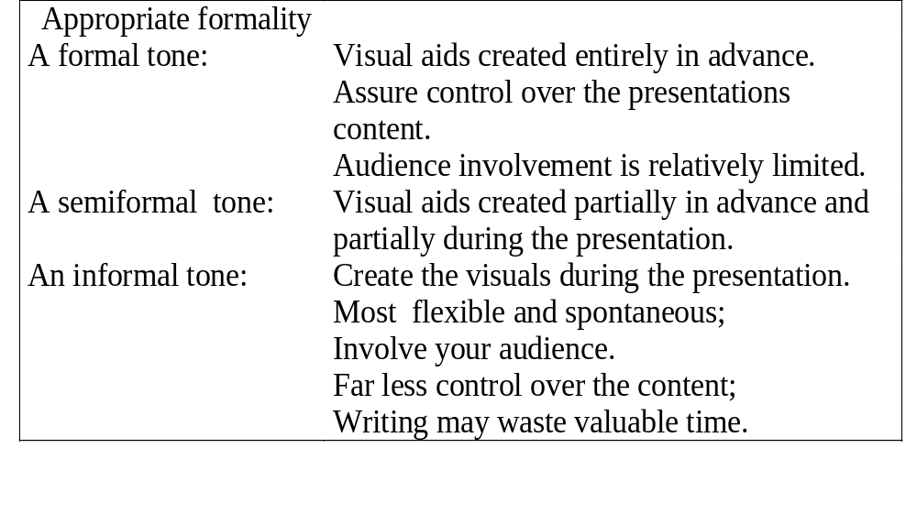
Select Your Visual Aids
Compose your visual aid content

Slide 25
Select Your Visual Aids
Necessary function
  Word chart Agenda or main idea
  Graph Illustrate relationships

Slide 26
Select Your Visual Aids
Easy readability
Avoid all unnecessary decoration
Do not overload
Use clear color coding
Include essential words only
Make sure your letter are large enough

Slide 27
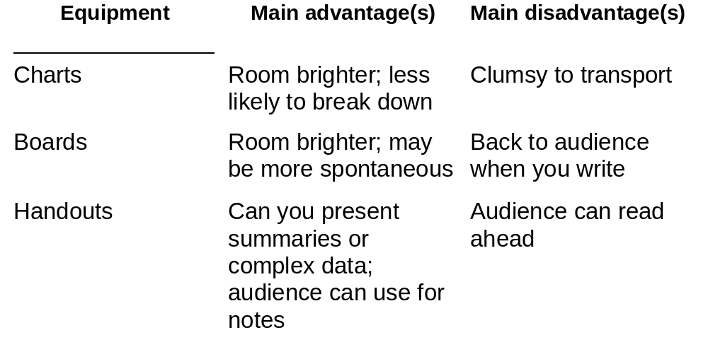
Select Your Visual Aids
Choose your visual aid equipment

Slide 28
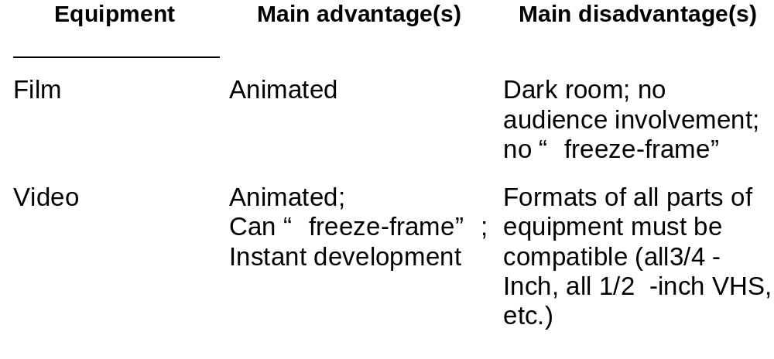
Select Your Visual Aids
Choose your visual aid equipment

Slide 29
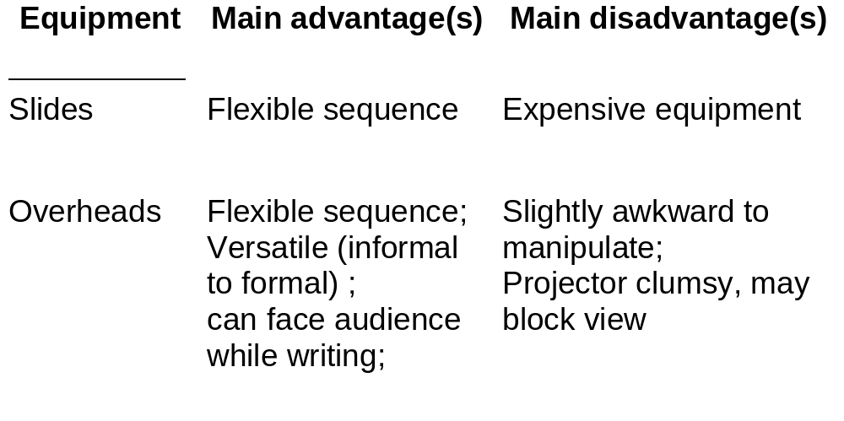
Select Your Visual Aids
Choose your visual aid equipment

Slide 30
Skills
Practice and arrange
Relax and gain confidence
Use your body effectively
Use your voice effectively

Slide 31
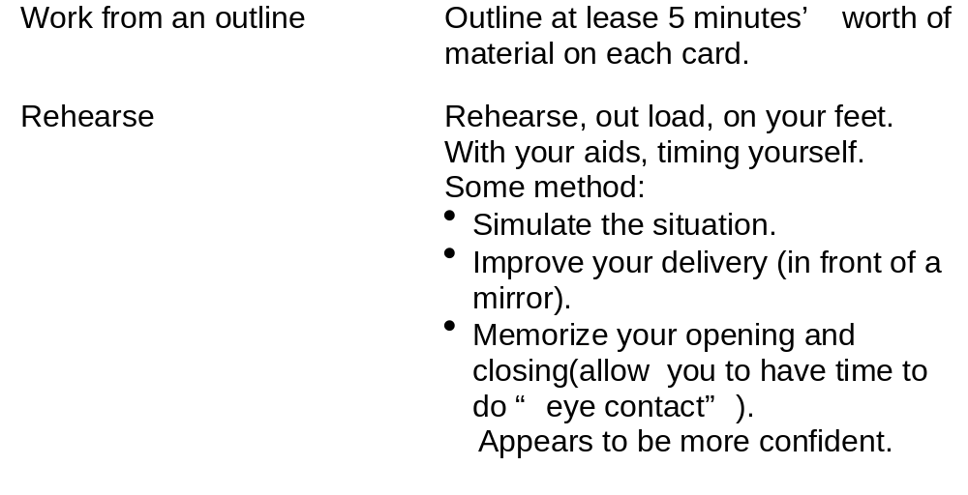
Practice & Arrange
Practice your presentation

Slide 32
Practice & Arrange
Practice with your visuals
Become familiar with equipment;
Practice integrating every visual smoothly into your presentation(metering out).
Practice some special techniques:
  Avoid writing too long or talk only to the board;
  Avoid talking to the screen if a projector is being used;
  Facing your audience if you are pointing

Slide 33
Practice & Arrange
Make the necessary arrangement for your presentation.
Audience notification
Room arrangement
Visual aids arrangement

Slide 34
Relax & Gain Confidence
Relaxing physically
Relax your entire body.
Relax specific body parts.
Relax your voice.
Relax physically at the last minute.
often through exercise
often deep breathing

Slide 35
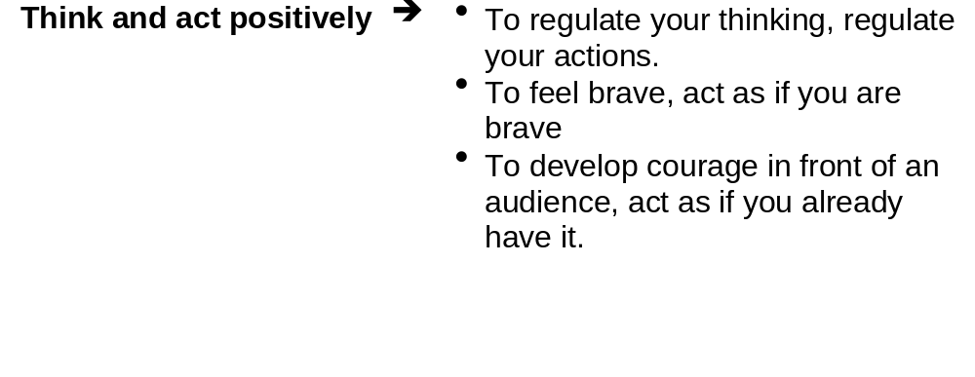
Relax & Gain Confidence
Relaxing mentally

Slide 36
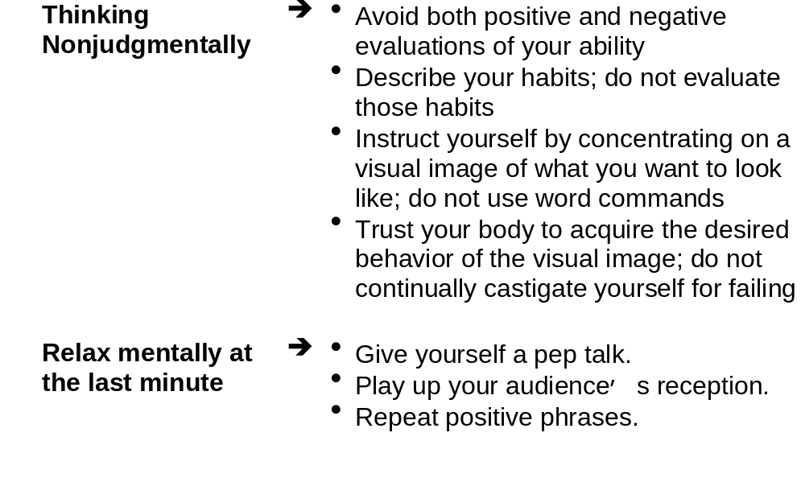
Relax & Gain Confidence
Relaxing mentally

Slide 37
Relax & Gain Confidence
Relax as you speak
Speak to the interested listeners.
Remember that you feel worse than you look.
Concentrate on the “here” and “now”.

Slide 38
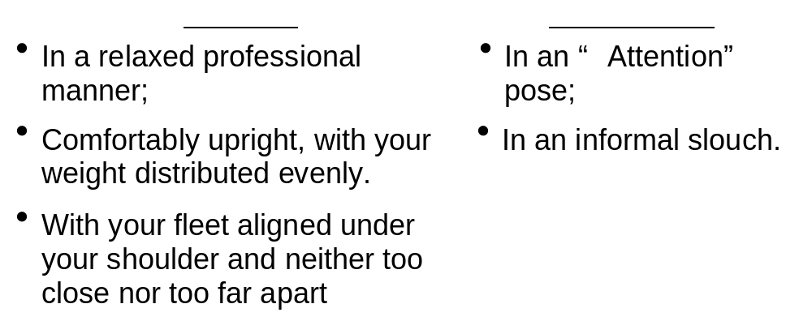
Use Your Body effectively
Improve your poise
Poise means general confidence and lack of tension.
Posture

Slide 39
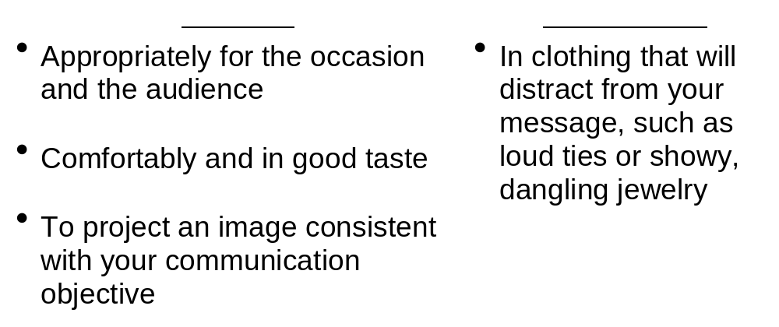
Use Your Body Effectively
Dress

Slide 40
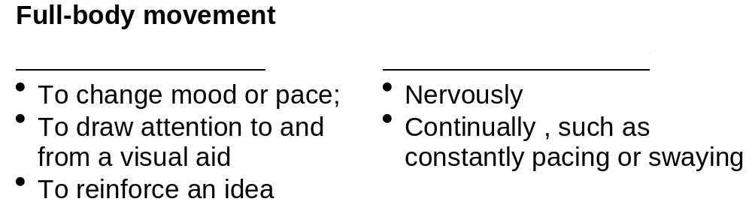
Use Your Body Effectively
Use movement and gestures

Slide 41
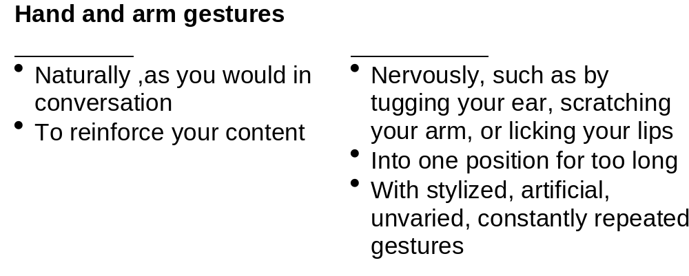
Use Your Body Effectively
Use movement and gestures

Slide 42
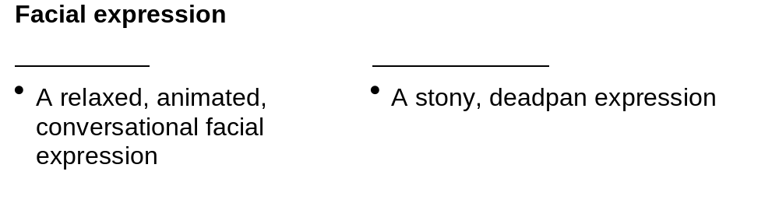
Use Your Body Effectively

Slide 43
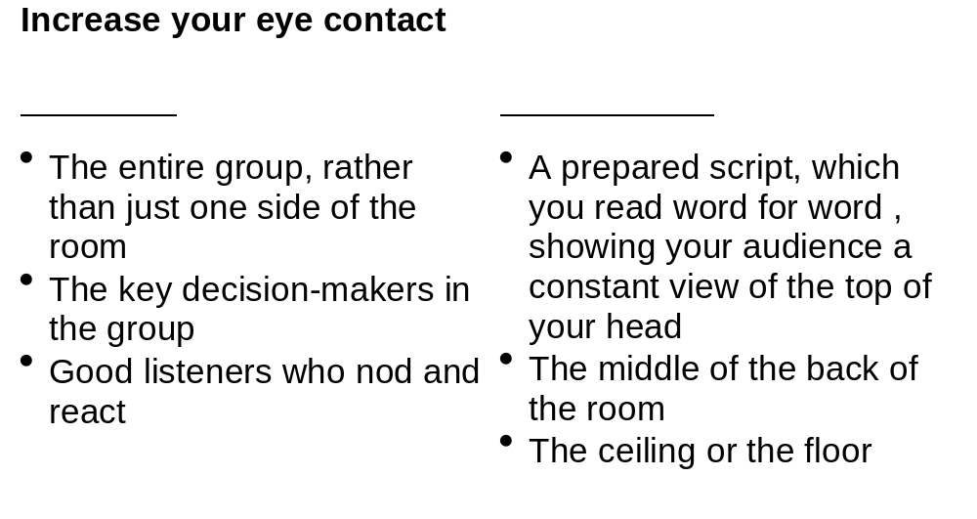
Use Your Body Effectively

Slide 44
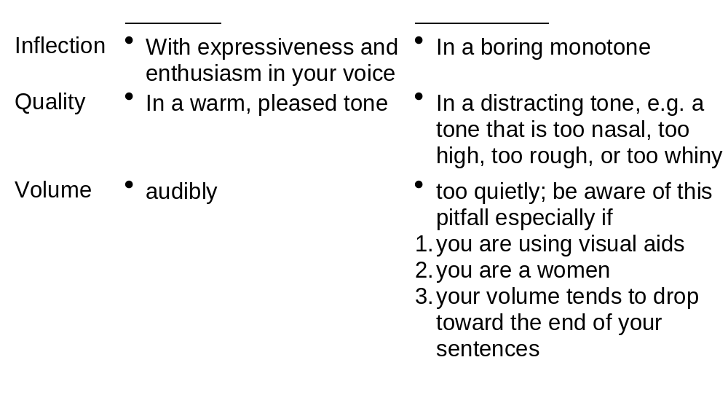
Use Your Voice Effectively
Use effectively pitch
Pitch means your voice’s inflection, quality and volume

Slide 45
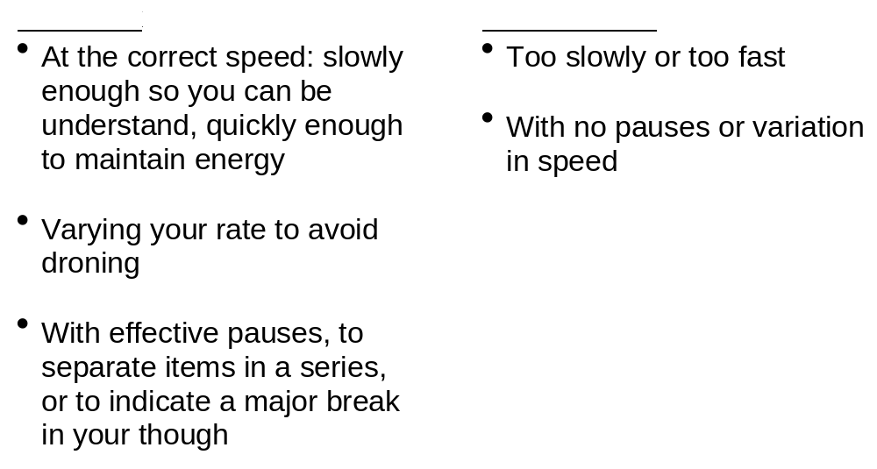
Use Your Voice Effectively
Speak at the correct rate

Slide 46
Use Your Voice Effectively
Avoid filler words
Enunciate clearly

